Slide 1

LAPTOP DATASET ANALYSIS
MEGANATHAN A – DA & DS

Slide 2


CONTENTS
1. DATA UNDERSTANDING
2. DATA CLEANING
3. OVERVIEW
4. EDA (Exploratory Data Analysis)
5. VISUALIZATION
6. INSIGHTS
7. FUTURE ENGINEERING

Slide 3


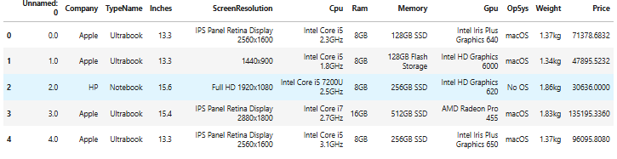
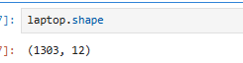
Data understanding
Data Types
Rows and columns
Testing
Finding Insights

Slide 4


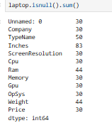
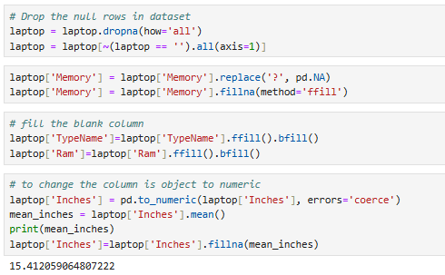
DATA CLEANING
1
2
3
Finding null values and replacing
Deleting the empty rows
Deleting the unwanted columns

Slide 5


Exploratory Data Analysis
Univariate Analysis: Explore distributions and summary statistics of individual variables such as laptop screen size, RAM, and price.
Bivariate Analysis: Investigate relationships between pairs of variables, such as price vs. specifications (RAM, CPU, GPU), screen size vs. weight, etc.
Multivariate Analysis: Examine interactions and dependencies among multiple variables, identifying correlations and patterns that may influence laptop pricing and performance.

Slide 6

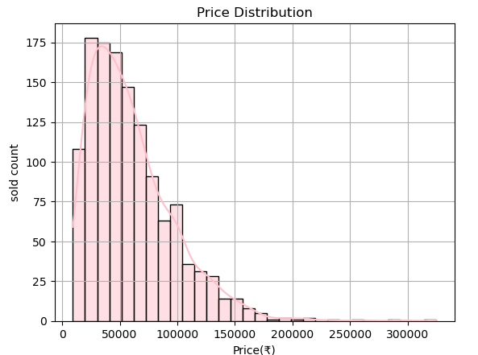
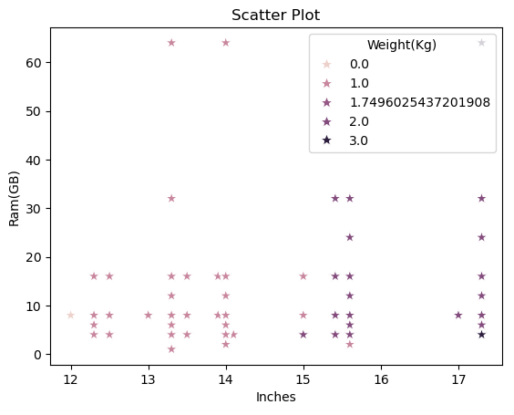
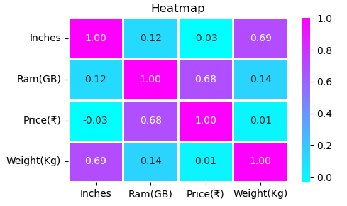
VISUALIZATION
Create insightful visualizations to illustrate trends, preferences, and market dynamics in the laptop industry.

Slide 7



INSIGHTS
8GB RAM have highest number of laptops.
Notebook have most number of laptops.
15 to 16 inches have highest number of laptops.
Apple – Ultrabook, Razer – gaming and Dell – workstation models is the highest number of price.
Razer gaming laptop is the highest inches.

Slide 8
FUTURE ENGINEERING
Key Findings:
Laptops with 2GB and 4GB RAM show higher sales compared to other configurations.
These models are likely affordable and attract budget-conscious customers.
Boosting Sales Strategy:
Offer complementary items like:
Free keyboard and mouse
Optional upgrade to SSD storage
Life time free MS Office acess

Slide 9


THANK YOU

